Slide 1
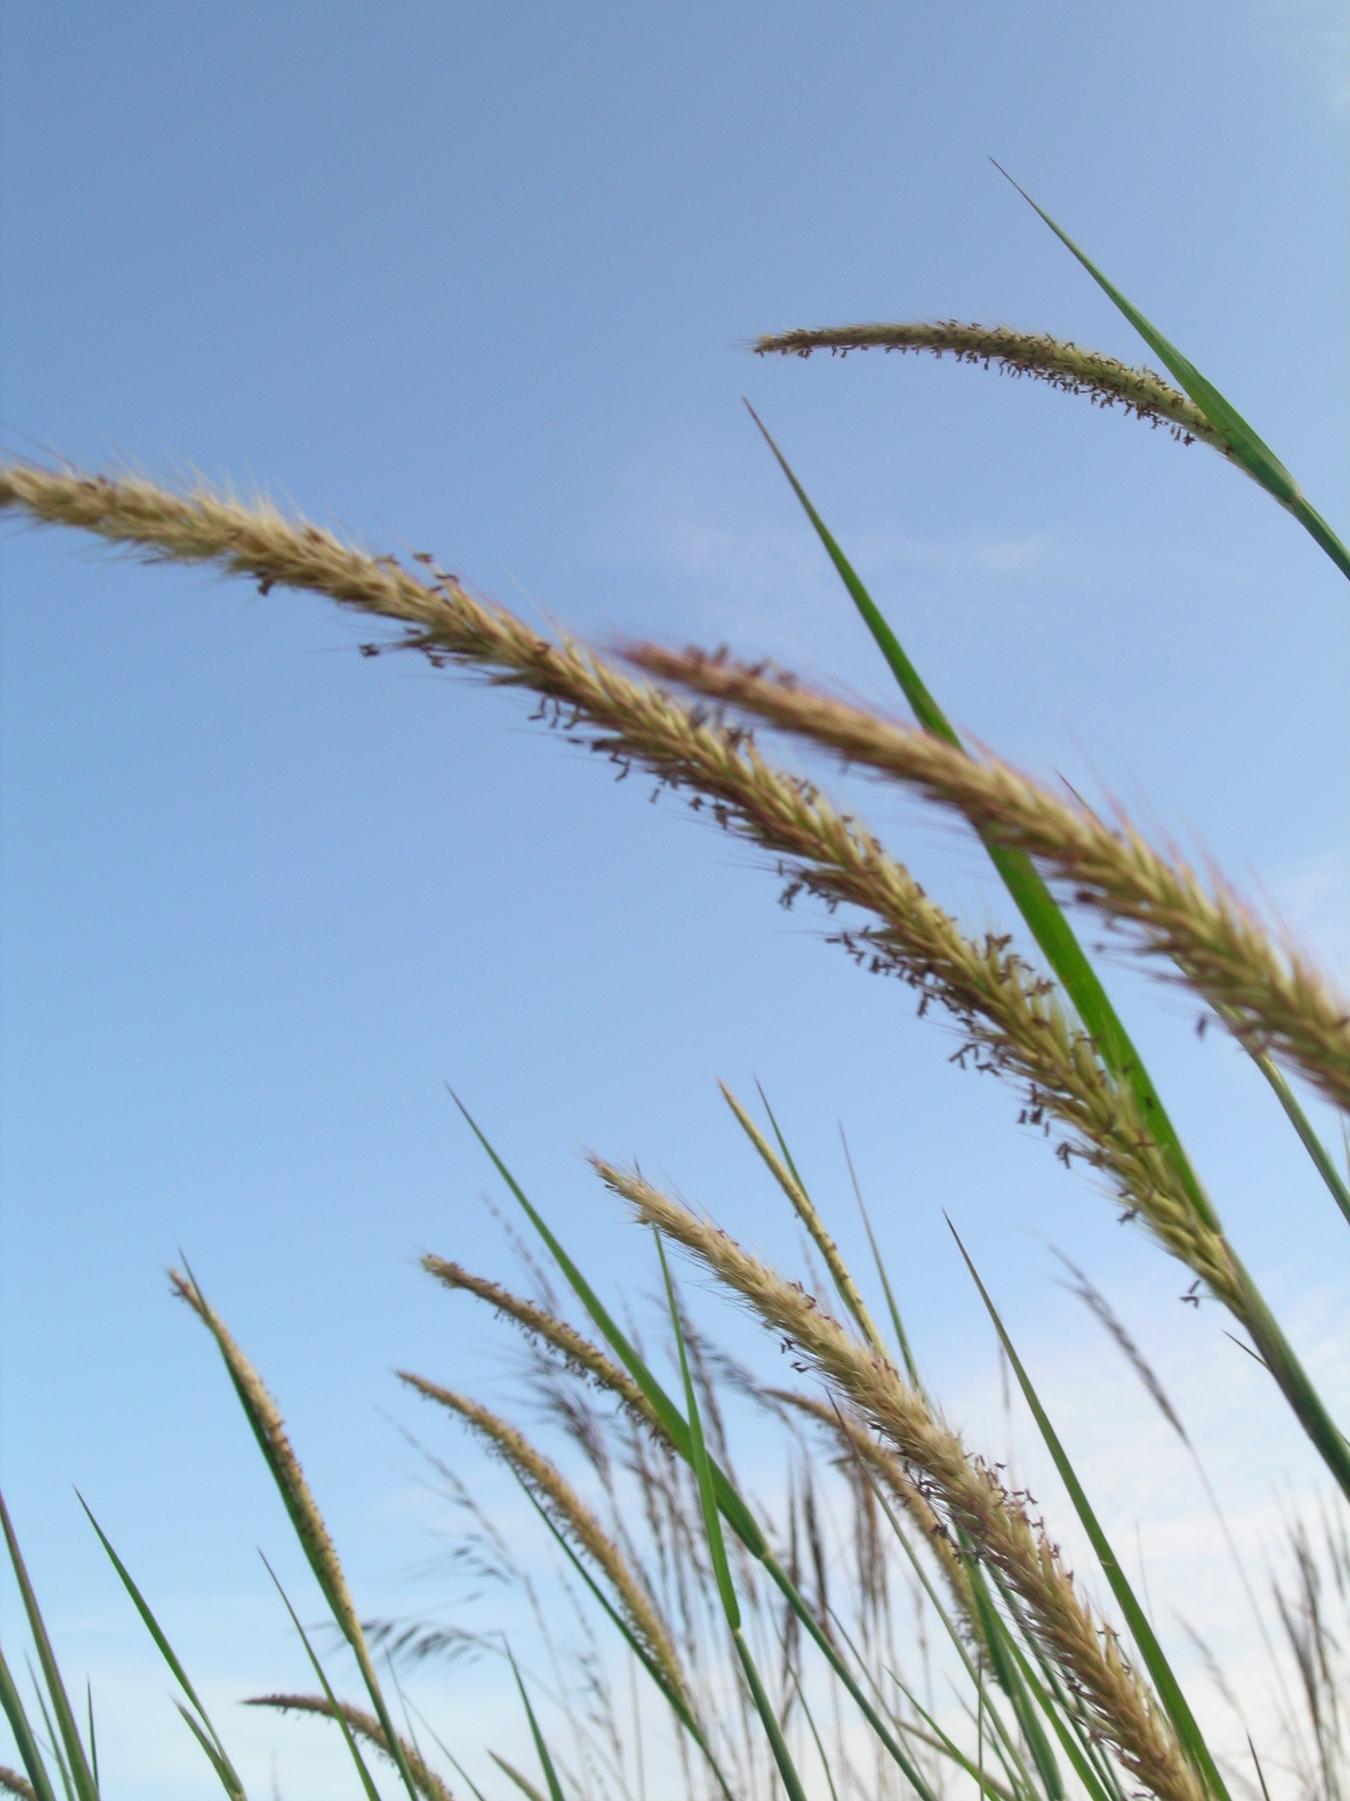
Tropical Plant Pollens and Allergic Rhinitis
Fay Johnston ^{1,2} and Ivan Hanigan ^{2,3,4}
1. Menzies Research Institute, University of Tasmania 2. School for Environmental Research, Charles Darwin University 3. National Centre for Epidemiology and Population Health, Australian National University 4. School of Plant Science, University of Tasmania
Background
Relatively little has been reported about the allergenicity of pollens from tropical plant families or their relative contributions to allergic disorders in these regions. We investigated associations between daily average fungal spore and pollen counts of several tropical plant families and sales of four medications commonly used to treat allergic rhinitis in Darwin, Australia, April 2004 to November 2005.
Methods
Five large pharmacies located in the Darwin suburbs of Palmerston, Leanyer, Nightcliff and Darwin provided daily sales data for loratadine/pseudoephedrine and fexofenidine tablets and beclomethasone and budenoside nasal sprays. We used Poisson generalized linear and categorical modelling to examine outcomes. All analyses accounted for the potential confounding effects of time trends, season, holidays, respiratory viral illnesses, meteorological conditions and air pollution.
Daily pharmacy sales, total pollen counts, and daily pollen counts of the three dominant plant families, Myrtacae (Eucalypts and Mellalueca), Arecaceae (Palms) and Poaceae (Grasses) Darwin Australia. April 2004-November 2005
Results
The peak total pollen count was 94 grains/m³ while the peak Poaceae (grass) pollen count was just 24 grains/m3. Daily sales of all products increased 5% with each interquartile range rise (3 grain/m³) in Poaceae pollen, greatest at a lag of 1 day (5.07 95%CI 1.04, 9.25). No associations were observed with fungal spores, the total pollen count or pollen from other plant families.
Conclusions
We found an association between tropical grass pollen and allergic rhinitis measurable at low pollen concentrations. As grass abundance is increasing in Darwin because of changed fire regimes and invasion by African grasses, these findings suggest that allergic rhinitis could become an increasing problem in the region.

